Slide 1
Understanding React, Tailwind (+RSBuild)
Tech stacks, research on the standard practices
Group A: Jie Hui and Yue Qin

Slide 2
Agenda
Prerequisites
React Overview
React: Advantages & Disadvantages
React Setup
TailwindCSS Overview
Tailwind: Advantages & Disadvantages
Tailwind Setup
RsBuild Overview
Tailwind VS. Bootstrap
Tailwind Over Bootstrap
React + Tailwind VS. Webpack + Bootstrap
Conclusion

Slide 3

Prerequisites
Download Node js before React installation process
Node.js is a JavaScript runtime environment that allows you to run JavaScript on the server side.
When writing React, the JavaScript functions in the React project, and Node.js will help to run this JavaScript code on the webpage.
Click Node.js — Download Node.js® to download

Slide 4
Why React Over JavaScript
Handles complex UIs more efficiently
Reusable components → faster development
Automatic UI updating with Virtual DOM
Cleaner code structure as projects scale
Supported by a large ecosystem & community

Slide 5

What is React?
React Overview
React is a free and open-source front-end JavaScript library that allows developers to build UIs using reusable components.
Use cases for React
Single Page Applications (SPAs)
Mobile App Development with React Native
Real time data rendering
Social Media such as Facebook for dynamic and interactive user interfaces

Slide 6
What is TypeScript?
TypeScript Overview
JavaScript with added types
Catches errors before the app runs
Makes React components more predictable
Better autocomplete and editor support
Helps large projects stay organized
Commonly used in modern React apps

Slide 7
React
Advantages
Disadvantages
Reusable components – developers build UI pieces and can be reused
Fast performance – react only changes parts of the page using Virtual DOM
React supports Search Engine Optimization (SEO) because JSX is structured like HTML
Limited opinionatedness - It is just a UI library and not a framework with few concept (JSX, Hooks, Component lifecycles)
Frequent updates – regular release of new versions and updates to the React library
Boilerplate code – setting up a full React project often requires repetitive configuration steps.

Slide 8

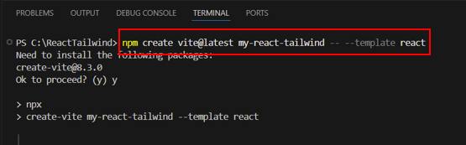
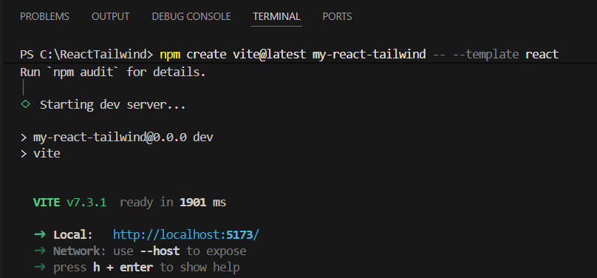
React Setup
In the Visual Studio Code Terminal
Run: npm create vite@latest my-react-tailwind -- --template react
Command instructs npm to download and run Vite’s project generator.
Creates new folder named my-react-tailwind with a complete React application
At the same time, Vite installs all required dependencies and prepares project for development.
.

Slide 9

What is TailwindCSS?
TailwindCSS Overview
Tailwind CSS is a modern, highly customizable, low level CSS framework that introduces single purpose utility classes for making styles HTML elements.
Use cases for TailwindCSS
Web development – web applications, websites, and landing pages
Responsive websites – using Tailwind's built in classes
Prototyping – enable styling directly in HTML
Component libraries – enable to create reusable components like buttons, cards, and navigation bars

Slide 10
Tailwind
Advantages
Disadvantages
Control over styling
It does not have a default theme to use like other CSS frameworks
Simplicity and speed
It offers thousands of built-in classes that do not require to create designs from scratch
Responsive design
It has its own responsive utilities to style elements for different screen sizes using simple modifier classes
Styling and HTML are mixed
Tailwind works differently than most CSS frameworks
Takes time to learn
Due to the built-in classes, it can be a challenge
Lack of important components
It does not have many significant styling components, and have to manually add features like headers, buttons, etc for web apps

Slide 11

Tailwind Setup
In the Visual Studio Code Terminal
Run:
npm install -D tailwindcss postcss autoprefixer
npx tailwindcss init -p
Commands install Tailwind + build dependencies and generate:
tailwind.config.js (customize design system)
postcss.config (integrates tailwind into build process)
In tailwind.config.js, set content paths:"./index.html", "./src/**/*.{js,ts,jsx,tsx}“
Add Tailwind directives to your main CSS file:
@tailwind base;
@tailwind components;
@tailwind utilities;
Notes:
In tailwind.config.js, set content paths:"./index.html", "./src/**/*.{js,ts,jsx,tsx}“
EXPLANATION: This tells Tailwind to scan only used files so it includes only the styles your project actually uses.

Slide 12

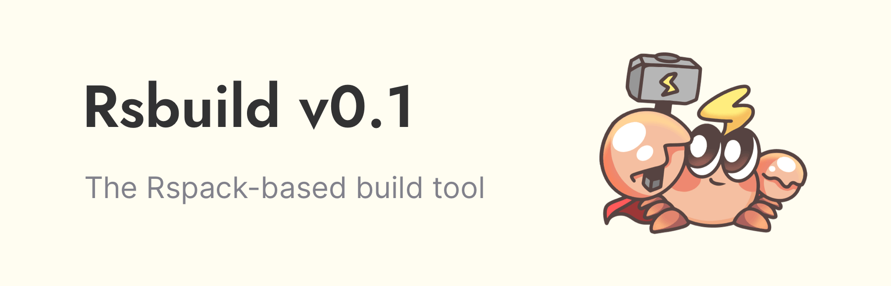
What is RsBuild?
RsBuild Overview
RsBuild is a fast, modern build tool built on top of Rspack—a super‑fast Rust‑based bundler
Provide developers with easy way to set up web projects
RsBuild Setup
In the Visual Studio Code Terminal
Run: npm install -D @rsbuild/core @rsbuild/plugin-react
Command installs RsBuild
Create a file named rsbuild.config.js
Add simple setup configuration
Notes:
providing developers with an easy, zero‑config way to set up, bundle, compile, and optimize web projects efficiently.

Slide 13

Tailwind VS. Bootstrap
Tailwind
Bootstrap
Provides low‑level, single‑purpose utility classes for spacing, color, layout, etc.
Tailwind prioritize speed and customization by eliminating the need for writing custom CSS for most tasks
Example:
<div class="bg-gray-100 border border-gray-300 rounded-lg p-4 max-w-sm"> <h2 class="text-lg font-semibold mb-2">Card Title</h2> <p class="text-gray-600">This is some content inside the card.</p> </div>
Provides pre‑styled, ready‑to‑use UI components (buttons, navbars, cards, etc.).
Developers can apply these classes directly to HTML elements without writing custom CSS
Example:
<div class="card"> <div class="card-body"> <h5 class="card-title">Card Title</h5> <p class="card-text">This is some content inside the card.</p> </div> </div>

Slide 14

React & Tailwind VS. Webpack & Bootstrap
Highly Customizable: Utility‑first design offers greater flexibility than traditional component-based frameworks (Nahar, 2025).
Better Performance:
React + Tailwind builds smaller bundles.
Webpack + Bootstrap often bundles extra unused code (Nahar, 2025).
Fits Modern Frameworks: Utility‑first CSS aligns naturally with React/Next.js component patterns (Qudah, 2024).
Different Purpose:
Webpack is a bundler, not a UI framework
Doesn’t provide UI structure
Integration Workflow Difference:
React + Tailwind uses modern, file‑based tooling (Vite/Next.js).
Webpack + Bootstrap requires more manual configuration
Better for Legacy Prototypes: Works well for fast, consistent layouts but lacks modern flexibility (Nahar, 2025).
14
Insert footer text here

Slide 15
Additional Enterprise Practices
Jest - Tests React logic + components
Babel + JSDOM
Babel: lets Jest understand modern
JSDOM: fake browser for component tests
Cypress
End‑to‑end testing
Tests full user flows in a real browser
Prettier - Auto‑formats code
15
Insert footer text here

Slide 16
Conclusion
React with Tailwind gives a modern, flexible, and efficient development experience.
Webpack with Bootstrap is a more traditional setup, stable but less customizable.
There’s no one ‘best’ stack. The right choice depends on the project and what the team needs.
16

Slide 17
References 1. GeeksforGeeks. (2023, December 13). Tailwind CSS Tutorial. GeeksforGeeks. https://www.geeksforgeeks.org/css/tailwind-css/
‌2. GeeksforGeeks. (2024, July 24). How React Works? GeeksforGeeks. https://www.geeksforgeeks.org/reactjs/how-react-works/ 3. Dana, N. (2023, November 17). Beginner’s Guide to Tailwind CSS. Medium; Tailwindcss. https://medium.com/tailwindui/beginners-guide-to-tailwind-css-5cf374dd08aa 4. Djirdeh, H. (2025, March 19). A Primer on Tailwind CSS: Pros, Cons and Real-World Use Cases. Telerik Blogs; Telerik. https://www.telerik.com/blogs/primer-tailwind-css-pros-cons-real-world-use-cases 5. Masters, R. (2023, October 30). Advantages and Disadvantages of React JS. Medium. https://medium.com/@reactmasters.in/advantages-and-disadvantages-of-react-js-e6c80b25763b 6. ReactJS - Advantages & Disadvantages. (2024). Tutorialspoint.com. https://www.tutorialspoint.com/reactjs/reactjs_advantages_and_disadvantages.htm
7. tefakhaled. (2025, July 27). Why You Should (or Shouldn’t) Use React: Pros and Cons Explained. Medium. https://medium.com/@mk01284740033/why-you-should-or-shouldnt-use-react-pros-and-cons-explained-630f8a8f4809 8. The Pros and Cons of Tailwind CSS | WDD. (2021, September 24). Web Designer Depot. https://webdesignerdepot.com/the-pros-and-cons-of-tailwind-css/ 9. Welcome To Zscaler Directory Authentication. (2026). Rsbuild.dev. https://v0.rsbuild.dev/guide/faq/general 10. DesignRevision. (2026, February 16). Tailwind vs Bootstrap: Which CSS framework? https://designrevision.com/blog/tailwind-vs-bootstrap 11. Drosopoulou, E. (2024, July 9). Tailwind CSS vs. Bootstrap: Utility-first vs. pre-built components. Java Code Geeks. https://www.javacodegeeks.com/2024/07/tailwind-css-vs-bootstrap-utility-first-vs-pre-built-components.html 12. Nihar Ranjan Das. (2025, August 22). Bootstrap vs Tailwind CSS comparison 2025. NiharDaily. https://www.nihardaily.com/69-bootstrap-vs-tailwind-css-which-css-framework-to-choose-in-2025 13. Qudah, M. (2024). Tailwind CSS vs Bootstrap: Complete comparison for developers. XHTMLTeam. https://www.xhtmlteam.com/blog/tailwind-vs-bootstrap-complete-comparison-for-developers/ 14. Trantor Inc. (2025, September 9). Tailwind vs Bootstrap CSS: Performance & flexibility compared. https://www.trantorinc.com/blog/tailwind-vs-bootstrap
‌
‌
‌
‌

Slide 18
Thank You!

